Slide 1
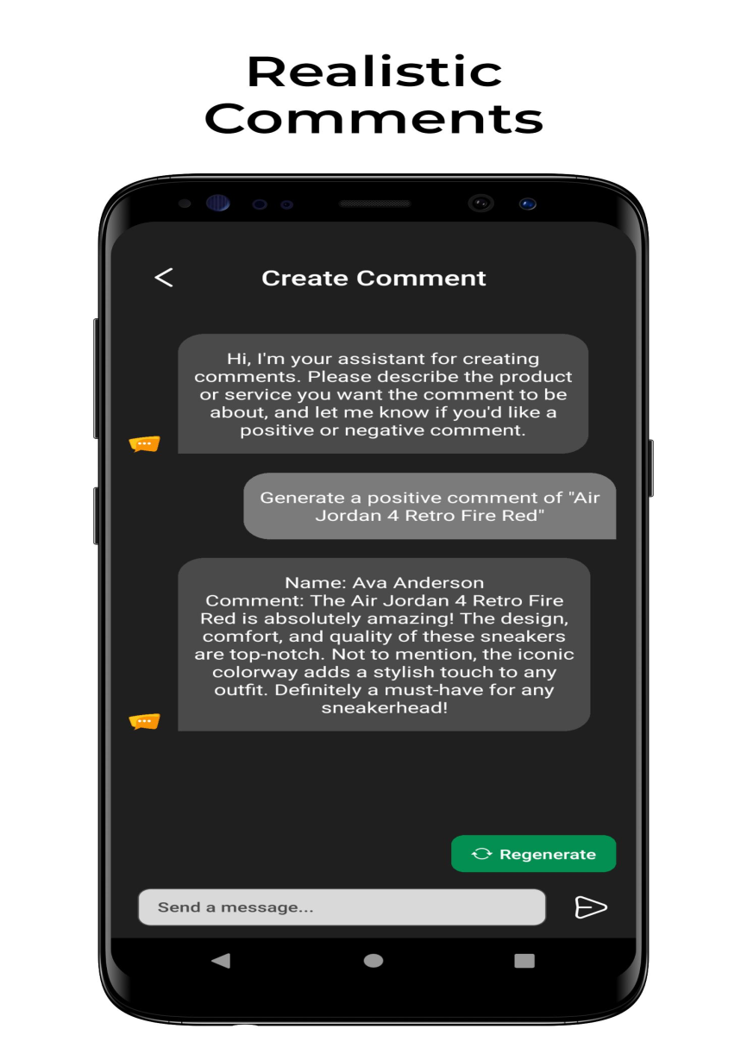
-by Jagruti Yewale
Comment Generator Tool

Slide 2
Objective-
The objective of a comment generator tool is to automatically produce text responses or comments based on given input. It aims to assist users in generating relevant, coherent, and contextually appropriate comments for various applications such as social media interactions, customer service responses, or content generation in natural language processing tasks.

Slide 3
Projects Overview
The comment generator tool automatically generates text responses based on input data, facilitating tasks such as social media interactions and customer service.
Leveraging techniques like the Markov chain model, it tokenizes input comments, builds transition dictionaries, and generates relevant comments from seed words.
Key features include efficiency, versatility across different comment types (positive, negative, neutral), and potential applications in content generation.
This tool aims to streamline communication processes and enhance user engagement through automated comment generation.

Slide 4
Working of Project -
In the comment generator tool, the process of generating comments involves several steps.
Firstly, the comments are tokenized, breaking them down into individual words.
Then, a transition dictionary is built, mapping each word to the words that typically follow it in the input comments.
Finally, when given a seed word as input, the generator selects the next word based on the seed word's transition dictionary, thereby generating coherent comments.
This method ensures that the generated comments maintain context and coherence, making the tool effective for various applications such as social media interactions and content generation.

Slide 5
Implementation -
In the Implementation section, we present the code snippet utilized for the comment generator tool.
This snippet typically includes key components such as data preprocessing, model architecture, and comment generation functions.
We highlight essential functions, such as tokenization and sequence generation, along with the neural network architecture, like LSTM layers. Furthermore, we discuss the libraries and tools employed, notably Python and its associated machine learning frameworks, such as TensorFlow or PyTorch.
This section offers insight into the technical aspects of the project, showcasing the implementation details crucial for understanding the functionality of the comment generator.

Slide 6

Application (pics) -
Facilitating social media interactions
Enhancing customer service responses
Aiding content generation tasks.
Provide insights to people discussion
Helping to understand the context and sentiment
Assist the content creation by suggesting ideas or angles based on generated comments.

Slide 7
Conclusion -
In conclusion, the comment generator tool offers an efficient solution for generating text responses across various contexts. Its ability to produce relevant comments enhances communication processes, social media engagement, and customer service interactions. We've discussed its importance, versatility, and potential applications, underscoring its value in modern communication.

Slide 8
THANK YOU

